Slide 1
Arrays in JAVA

Slide 2
Arrays
Array is collection of related or similar data items
Creating an array
  Declare an array
  Create memory location
  Putting values to memory locations

Slide 3
Declaring an Array Variable
  <type> [ ] variable_name;
  Double[ ] myList;
  double myList[ ];
Both syntaxes are equivalent
No memory allocation at this point

Slide 4
Defining an Array
Define an array as follows:
  variable_name=new <type>[arraySize];
  Number = new int[5];
  Mylist = new int[10];
It creates an array using new dataType[arraySize];
It assigns the reference of the newly created array to the variable variable_name.
dataType arrayname[ ] = {list of values};
Int a [ ]={1,2,3,4,5,6,7,};
Array index starts from 0 to arraySize-1;
int is of 4 bytes, total space=4*10=40 bytes
Declaring and defining in the same statement:
  Double [ ] mylist = new double[10];

Slide 5
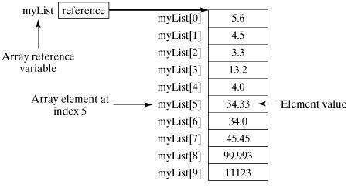
Creating arrays cntd...

Slide 6
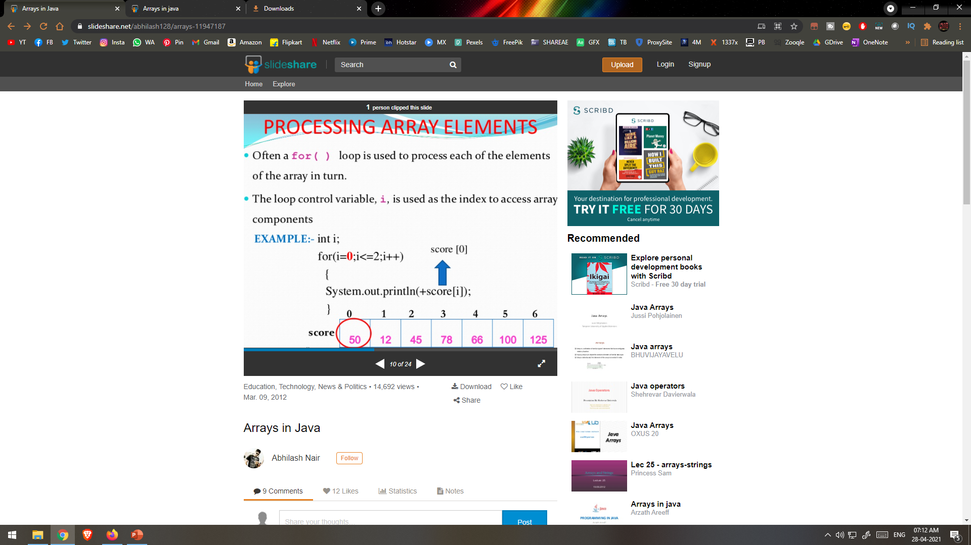

Slide 7
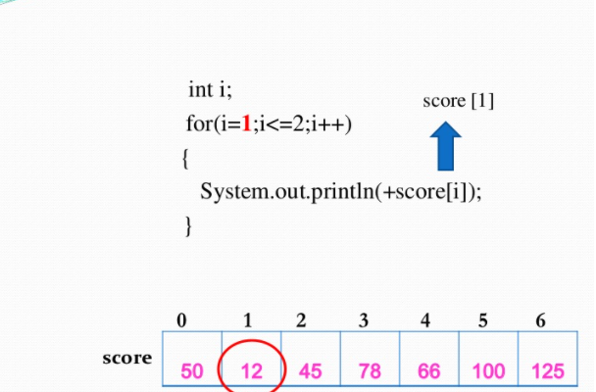


Slide 8
Array Length
Refer to array length using length() method
  A data member of array object
  array_variable_name.length
  for(int k=0; k<primes.length;k++)
Sample Code:
  long[ ] primes = new long[20];
  System.out.println(primes.length);
Output: 20
If number of elements in the array are changed, JAVA will automatically change the length attribute!

Slide 9
Sample Program
class MinArray
{
public static void main ( String[] args )
{
  int[] array = { 20, 19, 1, 5, 71, 27, 19, 95 } ;
  int min=array[0]; // initialize the current minimum
  for ( int index=0; index < array.length; index++ )
  {
  if ( array[ index ] < min )
  {min = array[ index ] ;}
  }
  System.out.println("The minimum of this array is: " + min );
}
}

Slide 10
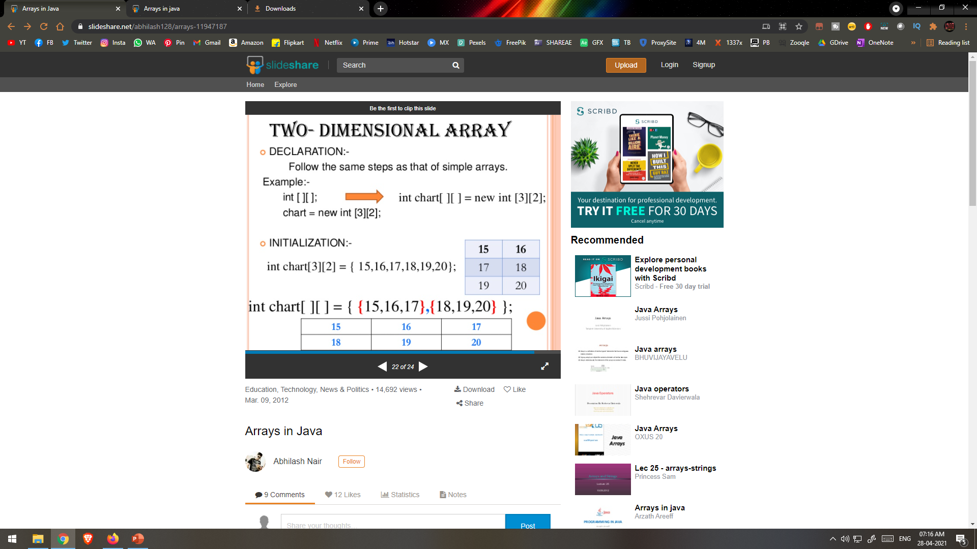
Two dimenssional array

Slide 11
THANK YOU

